Slide 1
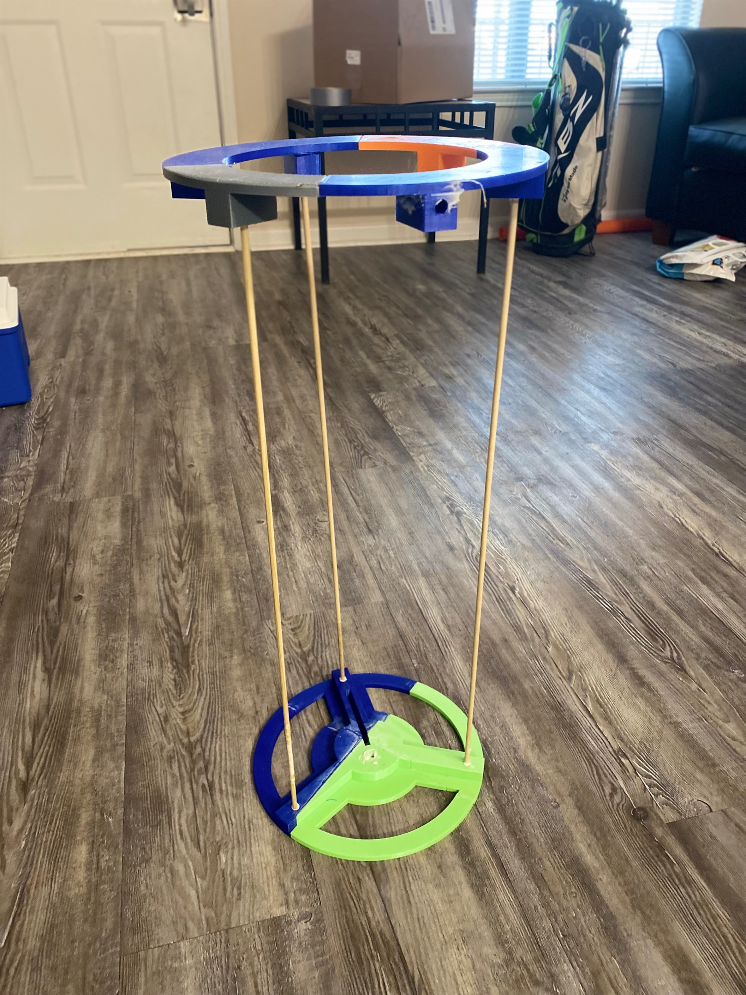
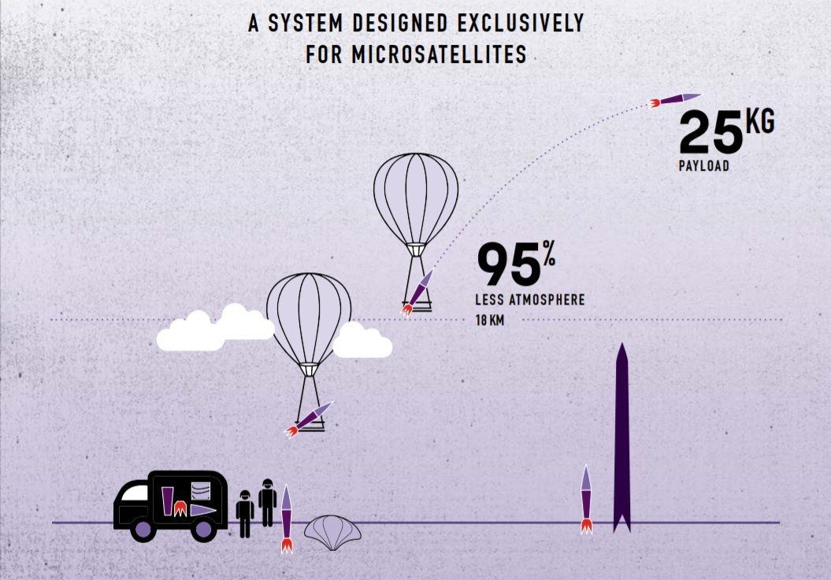
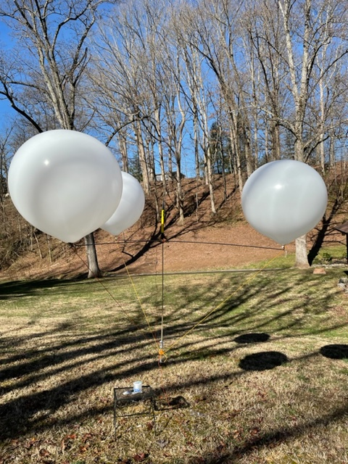
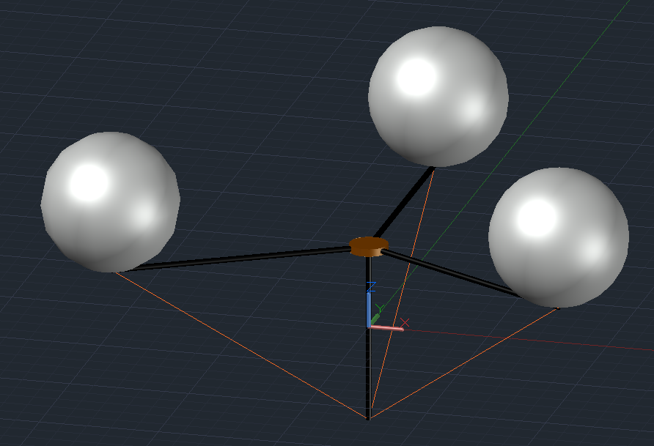
Balloon Assisted Launch System (BALS)
Team Members: Jesse Groves, Alexander Brown, Kyle Dolwick
Faculty Advisor: Evans Lyne
Project Description:
Design a system that will carry a rocket above the atmosphere to be launched. This will be accomplished by filling balloons with helium and remotely launching the rocket once it reaches the desired altitude. The purpose of this is to save on fuel as it is very inefficient to launch from the ground due to the weight of the fuel and the drag from the atmosphere.
Ref. 1
Design Specifications:
Should be able to effectively handle unsteady wind conditions, be able to launch remotely from high altitudes in a safe manner and be safely recovered after launch.
Design Methodology:
Our team researched similar projects done by other universities and companies. Many of these were one-balloon designs where the rocket was suspended beneath the balloon. After looking at other designs, our team decided to construct a unique design.
Final Design:
We went with a three-balloon design in which a rocket is launched from a plate located in the center of the balloons as shown below. The rocket is remotely launched via a code that checks for altitude and tilt angle of the rocket to ensure a safe launch at the proper altitude.
Results:
Our team conducted several small-scale tests to ensure stability, safety, feasibility, and to make sure that the code works properly. Our most recent test was a simulation of a full-scale launch in which the stand was tethered to the ground but was free-floating at the time of the launch. The code was able to initiate the launch and bring the stand down by popping one of the balloons.
Future Work:
To continue this project, the full-scale model will need to have a tethered test. After this is successfully completed, there needs to be communication with local air traffic control to gain clearance for this launch at higher altitudes.
Reference 1
https://phys.org/news/2018-04-rockoons-satellites-space-accessible.html
Other Projects
https://engineering.purdue.edu/IE/news/2019/hepfer-leo-rocket-launch
https://stanforddaily.com/2020/08/08/a-space-race-of-sorts-stanford-space-initiative-hopes-to-cross-into-space-with-a-rockoon/
Other Projects
http://www.astronautix.com/r/rockoon.html
https://spacenews.com/small-launch-startup-leo-aerospace-suspends-operations/

